Slide 1
Lecture # 07
ELEMENTS AND PRINCIPLES OF DESIGN & aesthetics

Slide 2
Design Elements
Elements of design are the things that are involved in making a design. Six integral components used in the creation of a design are:
Line
Color
Form and Shape
Space
Texture
Value

Slide 3
Line
Line defines the position and direction of design. It can define shape, convey mood etc.
Types
  Vertical
  Horizontal
  Diagonal
  Curved

Slide 4
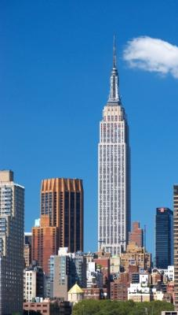
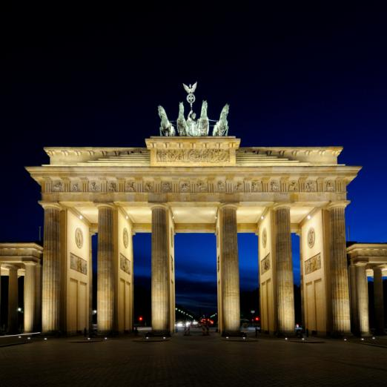
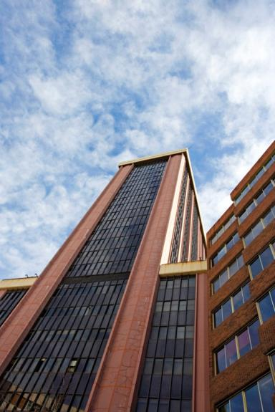
Vertical Lines
  Represents dignity, formality, stability, and strength
The Empire State Building, New York
Brandenburg Gate
Berlin
Skyscraper
Madrid, Spain

Slide 5
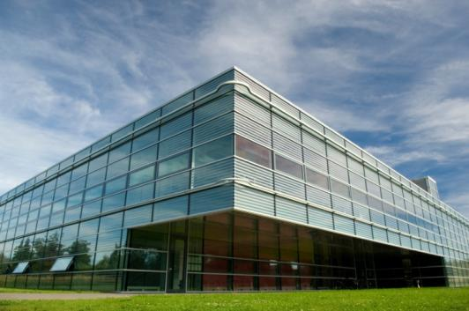
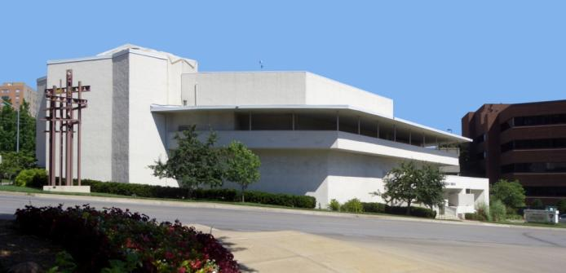
Horizontal Lines
  Represents calm, peace, and relaxation
Community Christian Church
Kansas City, MO
Architect: Frank Lloyd Wright, 1940

Slide 6
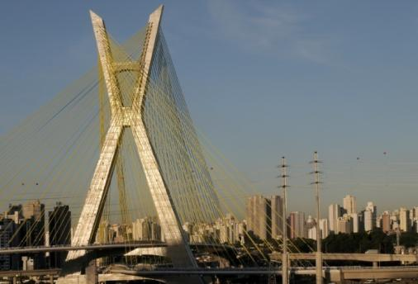
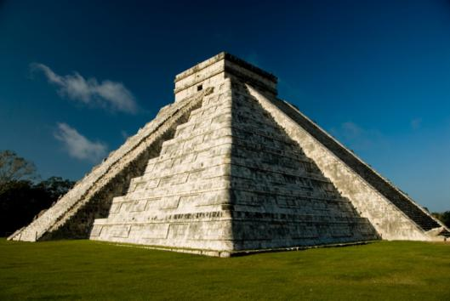
Diagonal Lines
  Represents action, activity, excitement, and movement
Octavio Frias de Oliverira Bridge in Sao Paulo, Brazil

Slide 7
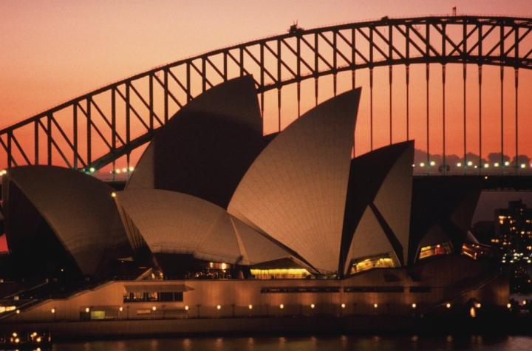
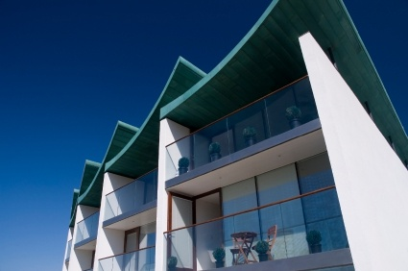
Curved Lines
  Represents freedom, the natural, having the appearance of softness, and creates a soothing feeling or mood
Sydney Opera House
Jorn Utzon

Slide 8
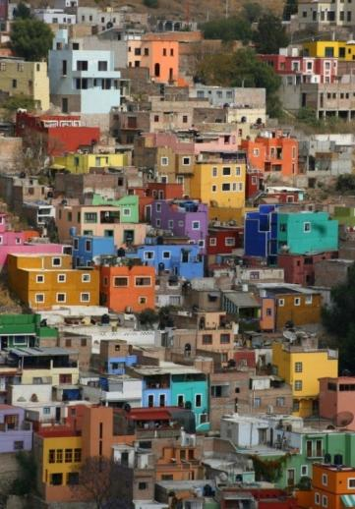
Color
Color is a property of light. Color has an immediate and profound effect on a design.
©iStockphoto.com
Saint Basil’s Cathedral
Moscow

Slide 9
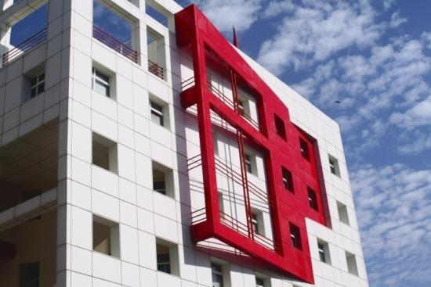
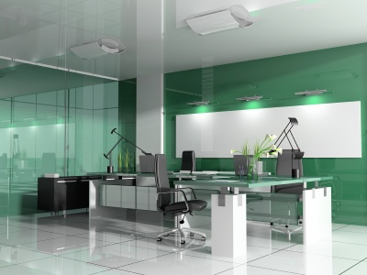
Color
  Warm Colors Cool Colors
  Reds, oranges, yellows Blues, purples, greens

Slide 10
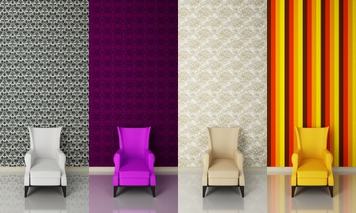
Color
  Colors can affect how humans feel and act

Slide 11
Form and Shape
Form: (3D)The shape and structure of something as distinguished from its substance or material.
Shape: (2D)The two-dimensional contour that characterizes an object or area.

Slide 12
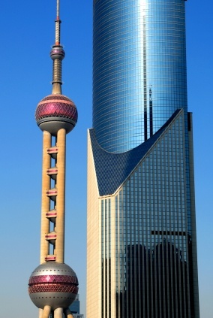
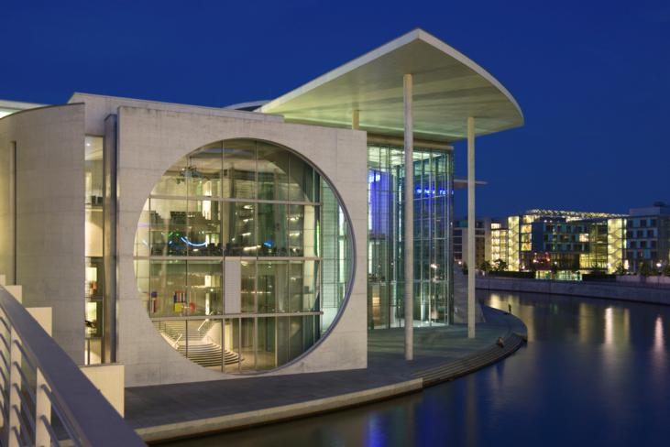
Form and Shape
Oriental Pearl Tower Shanghai
Marie-Elisabeth-Lüders-Haus
Berlin, Germany

Slide 13
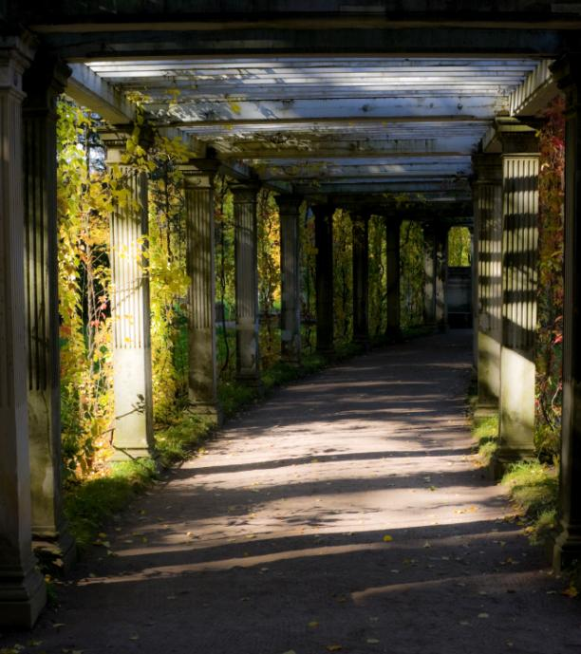
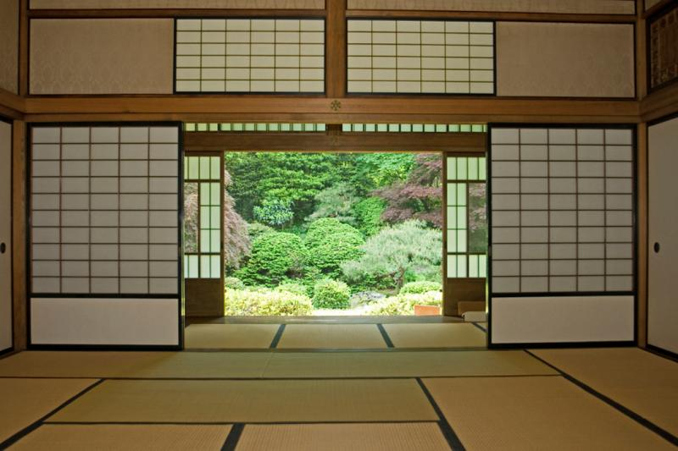
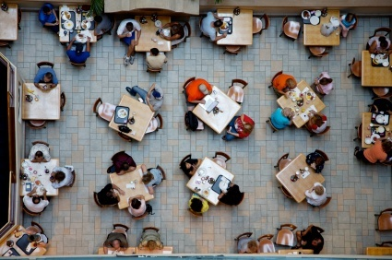
Space
By incorporating the use of space
in your design, you can enlarge or reduce the visual space.
Types
  Open, uncluttered spaces
  Cramped, busy spaces
  Unused vs. good use of space

Slide 14
Texture
The surface look or feel of something
Smooth Surface
Reflects more light and therefore is a more intense color.
Rough Surface
Absorbs more light and therefore appears darker.

Slide 15
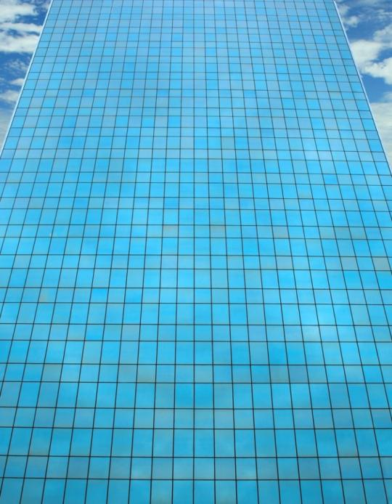
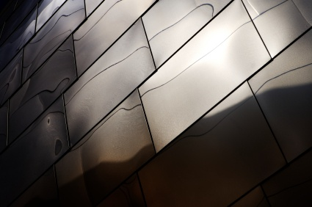
Smooth Texture
Glass façade of a high rise office building
Exterior metal façade of Disney Concert Hall
Los Angeles

Slide 16
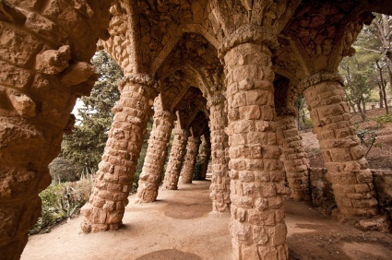
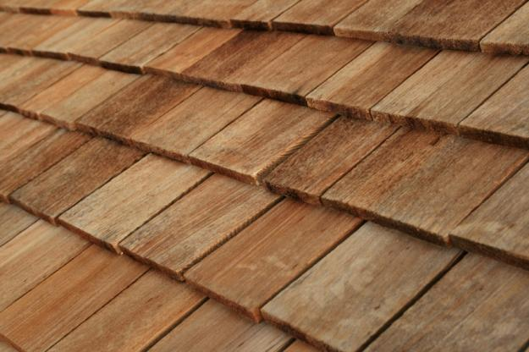
Rough Texture
Park Guell – Barcelona, Spain

Slide 17
Value
The relative lightness or darkness of a color
Methods
  Shade – Degree of darkness of a color
  Tint – A pale or faint variation of a color

Slide 18
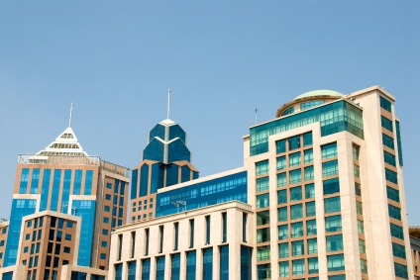
Value
Downtown buildings in Bangalore, India

Slide 19
Design Principles/ Elements of aesthetics
Principles of design are the rules which should be followed to design anything. Seven principles encompass an interesting design.
Balance
Rhythm
Emphasis
Proportion and scale
Movement
Contrast
Harmony

Slide 20
Balance
Parts of the design are equally distributed to create a sense of stability. Both physical and visual balance exist.
Types
  Symmetrical or formal balance
  Asymmetrical or informal balance
  Radial balance
  Vertical balance
  Horizontal balance

Slide 21
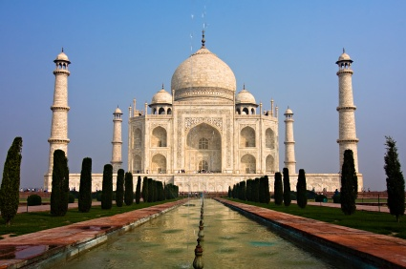
The elements within the design are identical in relation to a centerline or axis.
BALANCE
Symmetrical or Formal Balance
The Taj Mahal Mausoleum
Agra, India

Slide 22
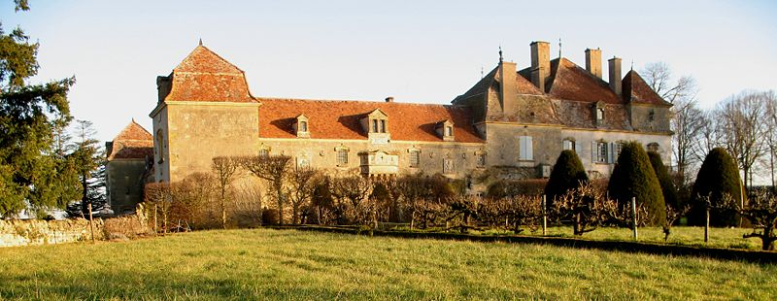
Balance
Asymmetrical or Informal Balance
Parts of the design are not identical but are equal in visual weight.
Chateau de Chaumont
Saone-et-Loire, France

Slide 23
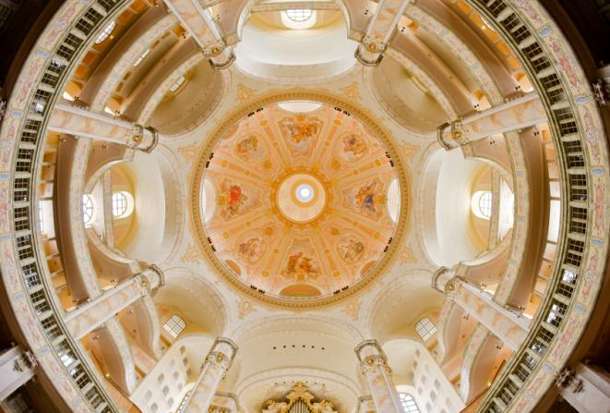
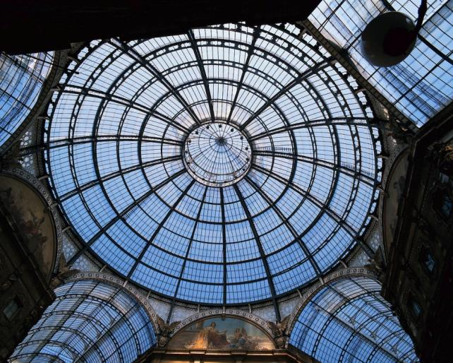
Balance
Radial Balance
Design elements radiate outward from the center.
Dresden Frauenkirche
Deresden, Germay
Galleria Vittorio Emanuele II
Milan, Italy

Slide 24
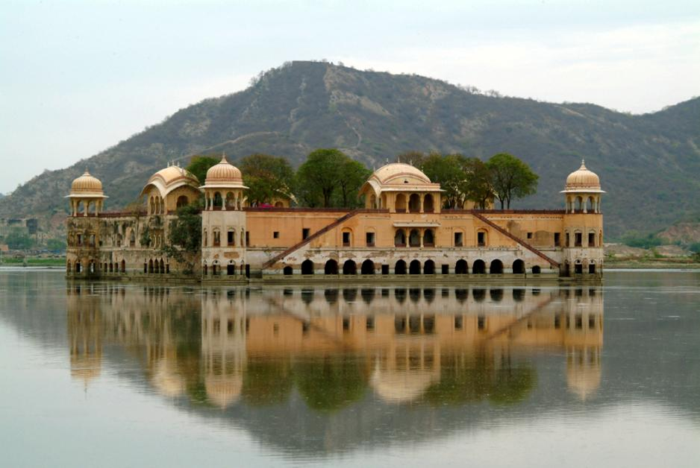
Balance
Vertical Balance
The top and bottom parts are equal.

Slide 25
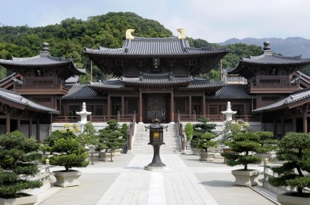
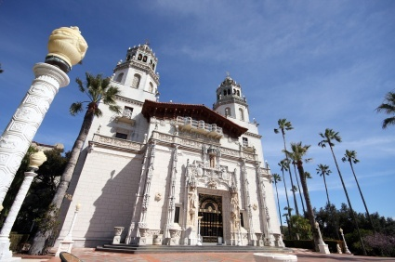
BALANCE
Horizontal Balance
The parts on the left and right sides are equal.
Chi Lin Buddhist Temple and Nunnery
Kowloon City, Hong Kong
Hearst Castle
San Simeon, California

Slide 26
RHYTHM
Repeated use of line, shape, color, texture or pattern
Types
  Regular rhythm
  Flowing rhythm
  Progressive rhythm

Slide 27
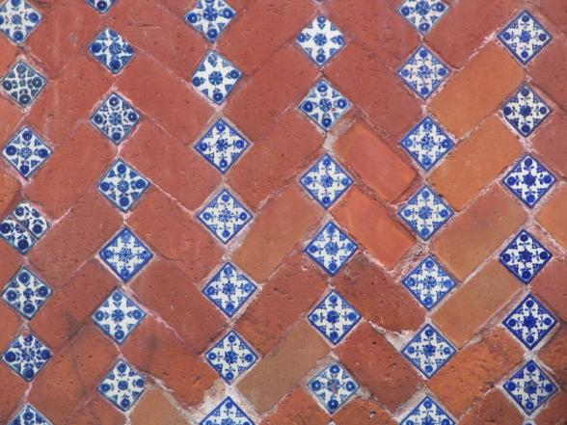
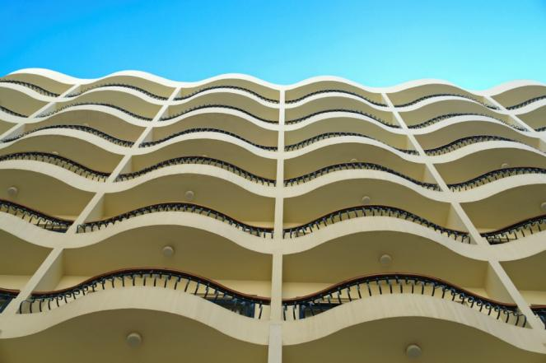
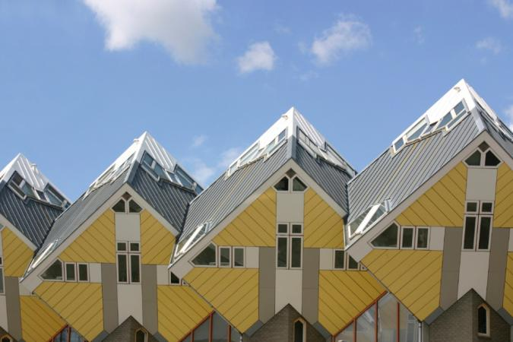
Rhythm
Regular Rhythm
An element is repeated at the same repetition or interval each time.
Cube house design
Rotterdam, Netherlands

Slide 28
Rhythm
Flowing Rhythm
The beats of the element are random or are at irregular intervals.
Saint Basil’s Cathedral.

Slide 29
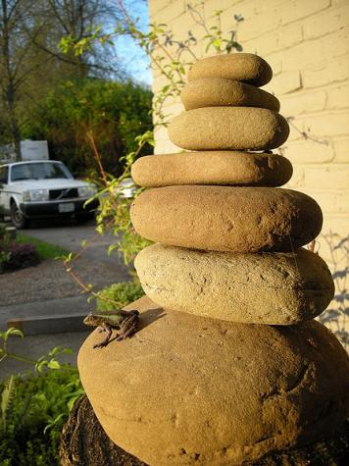
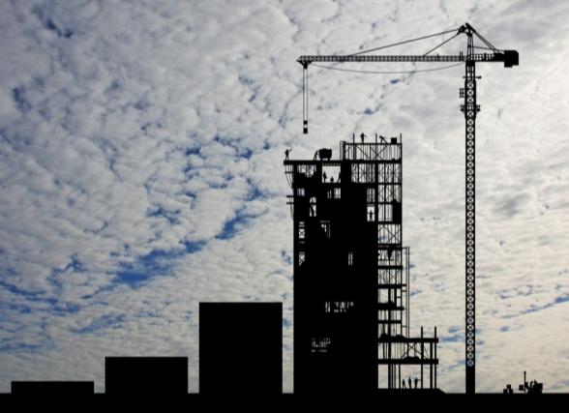
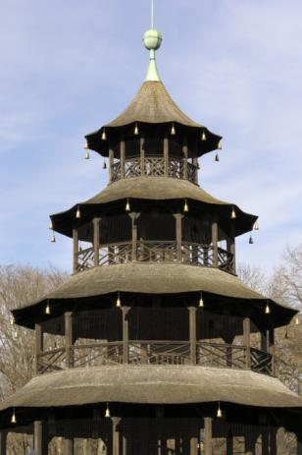
Rhythm
Gradated Rhythm
The repeated element is identical with the exception of one detail increasing or decreasing gradually with each repetition.
Left: Stack of rocks used as focal point in landscaping
Right: The Chinese Tower English Gardens
Munich, Germany

Slide 30
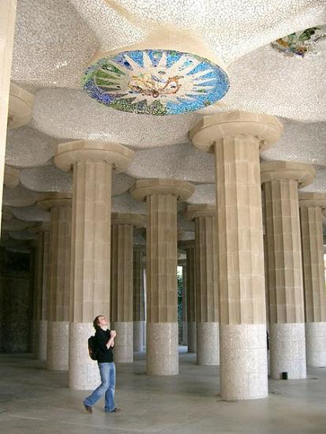
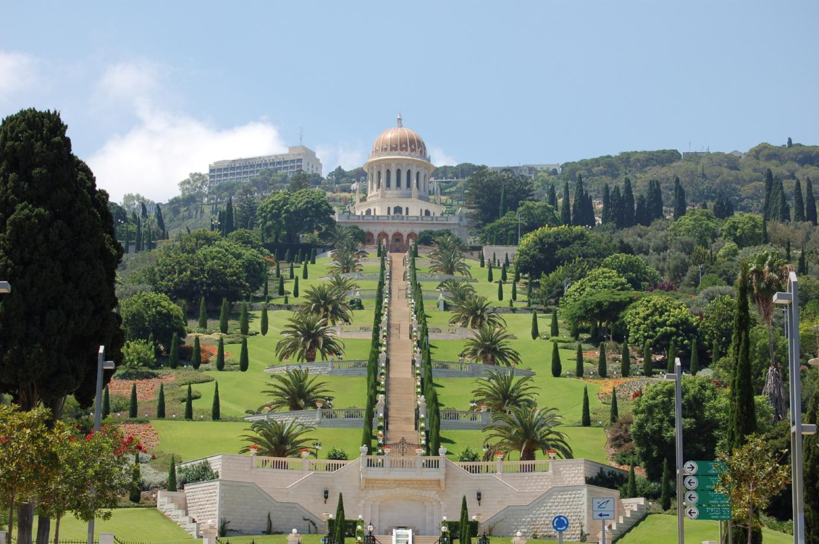
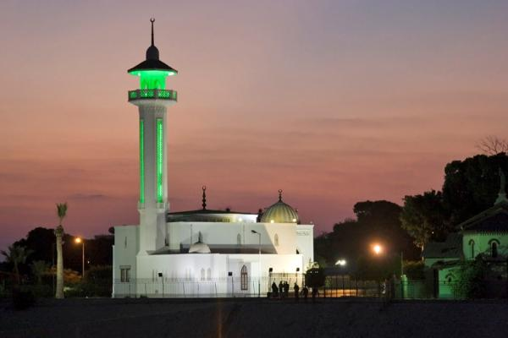
Emphasis
Wikipedia.org
The feature in a design that attracts one’s eye – the focal point
Emphasis can be achieved through size, placement, shape, color, and/or use of lines
Ceiling mosaic in Park Gruell
Mosque - Egypt

Slide 31
Proportion and Scale
Scale relates to the size of a design in relation to the height and width of the area in which it is placed.
Proportion relates to the parts of the object and how one part relates to another.
The creative use of color, texture, pattern, and furniture arrangement can create illusions of properly proportioned space.

Slide 32
Movement
Flow or feeling of action. Diagonal lines can create movement in design

Slide 33
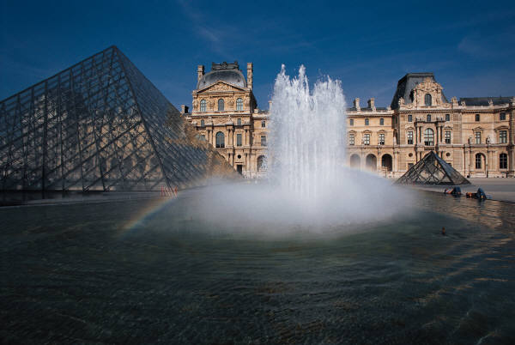
Contrast
It refers to the arrangement of opposite elements. (Light vs dark color, large vs small shape etc.) to create interest. Noticeably different
Can be created with
  Color
  Proportion and scale
  Shape
  Texture

Slide 34
HARMONY
It means all parts of the design relate and complement each other. Harmony can be achieved through:
Unity:
It is the quality of wholeness or oneness. It is achieved by the consistent use of lines, color, material, and/or texture within a design.
2. Variety:
All elements are combined to increase visual interest. (Creates Contrast)

Slide 35

UNITY

Slide 36

Unity

